Slide 1



C Synchronization Primitives

Slide 2
Intro to semaphores
Spinlocks (busy waiting) aren’t efficient
Modern operating systems can put processes to sleep and wake them up
File IO
Multi-tasking
Can you think of examples when this happens?
Combine ability to sleep and wake with atomic test and set

Slide 3
Intro to semaphores
Looks a lot like a counter with a couple of methods
Wait: decrement counter
If count < 0: Key is off the hook; go to sleep
If count >= 0: Key is on hook; take it and use it
Signal: increment counter
If pre-increment < 0: Wake up next in line

Slide 4
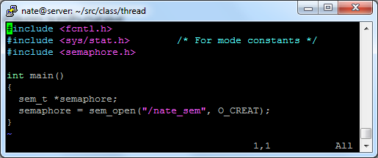
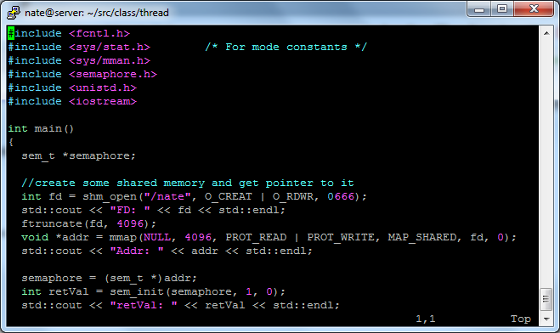
Let’s code some more
Two kinds of semaphores
Named
Unnamed

Slide 5
Named Semaphore Details
Creates a file in /dev/shm
Any process can open the file
File persists until unlinked

Slide 6
Unnamed Semaphore Details
Must first create shared memory
Use the heap for a thread – WHY?
Use shm_open or similar for processes – WHY?
The semaphore doesn’t show up as a file
Can’t communicate location via file system

Slide 7


Remember this? Can we now fix it?
$1000
$1000
$900
TIME
$900
float bal = fetchBalance();
bal -= 100;
dispenceCash(100);
setBalance(bal);
float bal = fetchBalance();
bal -= 100;
dispenceCash(100);
setBalance(bal);

Slide 8
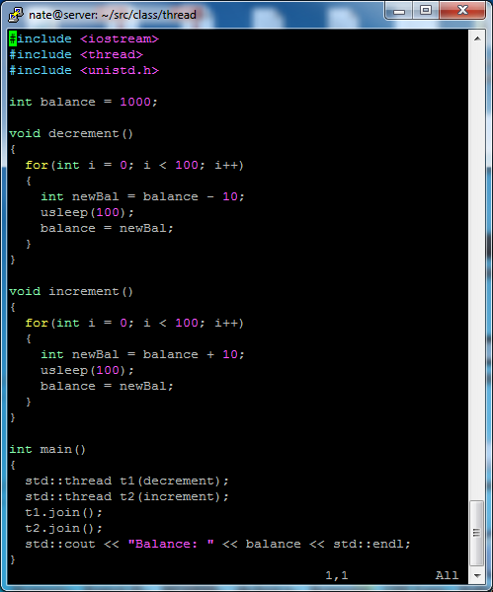
We know there race conditions in this code
Can you use semaphores to fix it?
Think about semaphore init value
These are the areas we need to protect
Code it

Slide 9
Remember that semaphores COUNT
The count is an indication of how many resources are free
This count can be used to signal another process to go
It may indicate how many times this other process should go
This is important for your next PEX

Slide 10
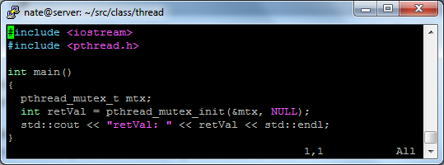
Intro to mutexes
Mutexes can also protect critical sections
They don’t count
Generally used in threads
Can be recursive, (but shouldn’t be)

Slide 11
Can you recode this using pthread mutexes?
These are the areas we need to protect
Code it

Slide 12
Inheritance and interfaces revisited
Can you create a base class that has a “lock” method
Two different derived classes, each implement lock a different way, (i.e. one uses semaphores the other uses mutexes)
Regardless of which derived class is instantiated, the code just works
Code it

